Slide 1
Corporate Sukuk Market
Day Three – World Bank, Arab Monetary Fund Seminar on Development of Sukuk Markets, Abu Dhabi, April 19-23, 2015
Session 1 2:
Ijlal Ahmed Alvi
Chief Executive Officer
IIFM

Slide 2
Global Sukuk Issuances – All Currencies
(Jan 2001 – March 2015,USD Millions)
Source: IIFM Sukuk Database

Slide 3
International Sukuk Issuances ( Jan 2001 – March 2015,USD Millions)
Total International Sukuk Issued $138.680 bio
Source: IIFM Sukuk Database

Slide 4
Domestic Sukuk Issuances (Jan 2001 – March 2015,USD Millions)
Total Domestic Sukuk Issued $599.634 bio
Source: IIFM Sukuk Database

Slide 5
International Sukuk Issuances By Issuer Status
(Jan 2001 – March 2015,USD Millions)
Source: IIFM Sukuk Database

Slide 6
Domestic Sukuk Issuances By Issuer Status
(Jan 2001 – March 2015,USD Millions)
Source: IIFM Sukuk Database

Slide 7
Structural Break-Up of International Corporate Sukuk Issuances (Jan 2001 – March 2015,USD Millions)
Source: IIFM Sukuk Database

Slide 8
Structural Break-Up of Domestic Corporate Sukuk Issuances (Jan 2001 – March 2015,USD Millions)
Source: IIFM Sukuk Database

Slide 9
Currency Break-Up of Domestic Corporate Sukuk Issuances (Jan 2001 – March 2015)
Source: IIFM Sukuk Database

Slide 10
Currency Break-Up of International Corporate Sukuk Issuances (Jan 2001 – March 2015)
Source: IIFM Sukuk Database

Slide 11
Country wise Break-Up of Global Corporate Sukuk Issuances (Domestic & International, Jan 2001 – March 2015)
Source: IIFM Sukuk Database

Slide 12
Break-Up of Global Corporate Sukuk Issuances by Tenor (Domestic & International, Jan 2001 – March 2015)
Source: IIFM Sukuk Database

Slide 13
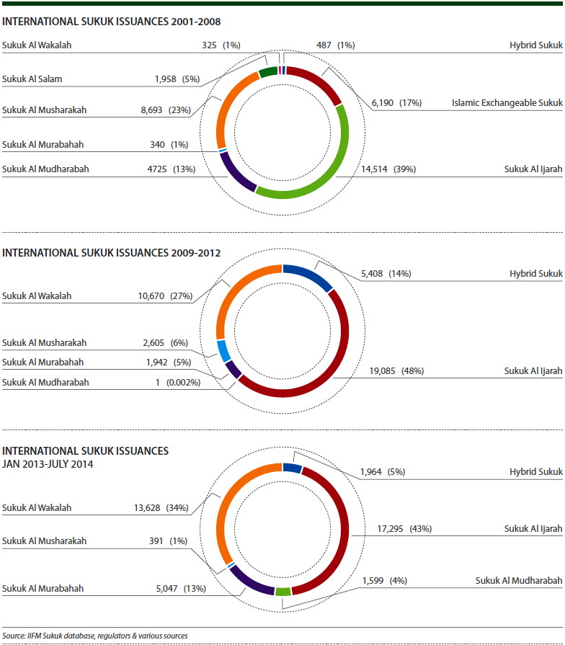
Structural Break-Up of International Sukuk
(Jan 2001 – July 2014,USD Millions)

Slide 14
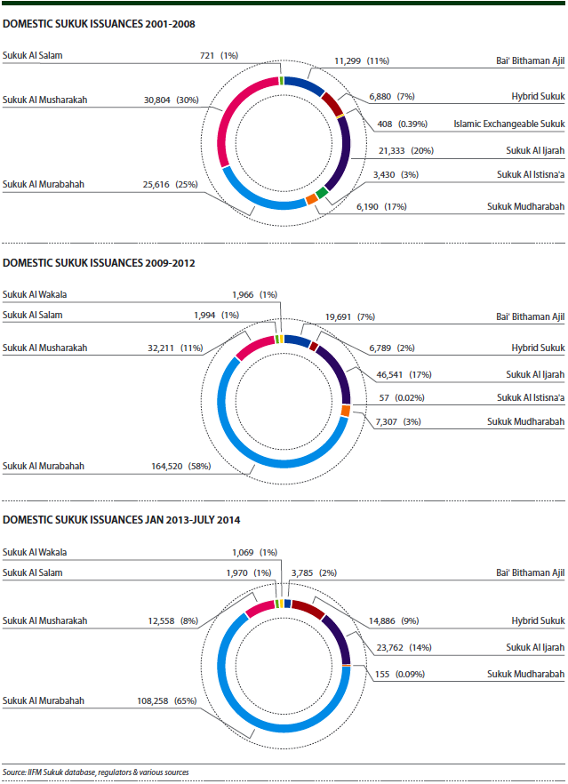
Structural Break-Up of Domestic Sukuk
(Jan 2001 – July 2014,USD Millions)

Slide 15
Long Tenor Global Sukuk Issuances
Total Long term Sukuk $137 bio (2001-July 2014)
The Sukuk market across the globe has historically suffered from a lack of longer maturity tenors, which
presents a pressing problem for banks, financial institutions, pension funds and insurance companies
which are trying to match durations of their liabilities in a Shari ‘ah compliant manner. The last five years, however, have seen a trend towards longer maturity issues from all parts of the world, especially from Malaysia. As of 2013, longer maturity Sukuk issues of tenors ten years and above form almost 20% of the total Sukuk issued as against 9.5% in 2009 with the greatest surge seen in the group with tenors between 10 and 20 years.

Slide 16
Global Corporate Sukuk Issuances – Selected Value Leaders
Issue Year | Issuer | Issuer Country | Issuance Currency | International/Domestic | Structure | Amount in USD Mio or Equivalent | Tenor (Months)
2015 | Emirates Airlines | United Arab Emirates | USD | International | Sukuk Al Ijarah | 913 | 120
2015 | Sharjah Islamic Bank | United Arab Emirates | USD | International | Sukuk Al Wakalah | 500 | 60
2015 | Dubai Islamic Bank | United Arab Emirates | USD | International | Sukuk Al Mudharabah | 1,000 | Perpetual
2014 | Flydubai | United Arab Emirates | USD | International | Sukuk Al Wakalah | 500 | 60
2014 | The Goldman Sachs | United States | USD | International | Sukuk Al Wakalah | 500 | 60
2014 | Al Hilal Bank | United Arab Emirates | USD | International | Sukuk Al Mudharabah | 500 | Perpetual
2014 | Kuveyt Türk Participation Bank | Turkey | USD | International | Hybrid Sukuk | 500 | 60
2014 | Banque Saudi Fransi | Saudi Arabia | SAR | Domestic | Sukuk Al Ijarah | 533 | 120
2014 | Emaar Malls Group | United Arab Emirates | USD | International | Sukuk Al Wakalah | 750 | 120
2014 | Saudi Telecom | Saudi Arabia | SAR | Domestic | Hybrid Sukuk | 533 | 120
2014 | Saudi Investment Bank | Saudi Arabia | SAR | Domestic | Hybrid Sukuk | 533 | 120
2014 | Turkiye Finans | Turkey | USD | International | Sukuk Al Murabahah | 500 | 60
2014 | Damac Properties | United Arab Emirates | USD | International | Sukuk Al Ijarah | 650 | 60
2014 | National Commercial Bank | Saudi Arabia | SAR | Domestic | Hybrid Sukuk | 1,300 | 60
2013 | GEMS Education | United Arab Emirates | USD | International | Sukuk Al Mudharabah | 200 | Perpetual
Source: IIFM Sukuk Database

Slide 17
Emaar Malls Group Sukuk Transaction Summary
Issuer | EMG Sukuk Limited
Obligor | Emaar Malls Group LLC (“EMG”)
Country of Transaction | United Arab Emirates
Issue Type | Fixed Rate Trust Certificates
Issue Size | USD 750 million
Issue Rating | Baa2 (Moody’s) / BBB- (S&P)
Pricing Date | 11 June 2014
Issue Date | 18 June 2014
Tenor | 10-year
Maturity | 18 June 2024
Profit Rate | 4.564%
Issue Format | Reg S only
Listing | Nasdaq Dubai
Governing Law | English Law and Dubai Law
Joint Lead Managers | ADIB, AHB, DIB, ENBD Capital, FGB, Mashreq, Morgan Stanley, NBAD, Noor Bank, Standard Chartered Bank and UNB
Emaar Malls Group LLC is a leading owner and operator of shopping malls in Dubai having established some of the most iconic malls and entertainment and lifestyle centres in the UAE which serve as a major attraction to international visitors. The Company’s portfolio of companies comprises of four shopping malls and 31 community shopping centres which are strategically located in key areas of Dubai, benefitting from population growth and increasing tourist attractions. Emaar Malls is also preparing for a potential initial public offering over the course of 2014 where it will float minimum 15% of its share capital.

Slide 18
Emaar Malls Group Structure Diagram
Emaar Malls as seller of Wakala Assets
Emaar Malls as purchaser of Wakala Assets (Obligor)
Emaar Malls as Servicing Agent
Payment of Exercise Price
Proceeds
Revenues from Wakala Assets
Purchase Undertaking/Sale Undertaking
Wakala Assets
Sale and Purchase Agreement
Service Agency Agreement
Issuer and Trustee
Proceeds
Periodic Distribution Amounts and Dissolution Distribution Amounts
Certificates
Declaration of Trust
Legend:
Certificateholders
= cash flows
= agreement/asset transfer

Slide 19
GEMS MEA Sukuk Transaction Summary
Issuer | GEMS MEA Sukuk Limited
Issue Rating | Not Rated
Status | Unsecured and subordinated
Format | Regulation S
Pricing Date | 14th November 2013
Settlement Date | 21st November 2013
Issue Size | USD 200,000,000
Maturity Date | Perpetual
Profit Rate | 12.00% p.a., semi-annual payments, reset after 5-years to a new fixed rate equal to the then 5-year USD Mid Swap + Initial Credit Margin + Profit Rate Step-up (5%)
Profit Rate Step-Up | One time step-up of 5.0% on 21 November 2018
Mid-swap Level | 1.465%
Reoffer Spread vs Midswap | 10.535%
Profit Rate Payment Deferral: | Cumulative, with deferral, at Mudareb’s discretion as detailed in the Preliminary Prospectus
Change of Control | Varkey family ceases to directly and indirectly control or own 50%+ of the business) call at the face amount together with any outstanding payments (if not called 500bps profit rate step-up);
Listing | Irish Stock Exchange and Nasdaq Dubai
Governing Law | English Law
ADIB | Structuring advisor and Joint Bookrunner
GEMS Education Ltd. founded in 1968 is the world’s biggest privately-owned operator of schools. The GEMS global education business (GEMS Education), operating through GEMS MENASA TopCo (Cayman) Limited (TopCo) and its subsidiaries, is among the world’s largest providers of high quality private education and related services. GEMS Education has grown, since its inception with a single school in Dubai (Our Own English High School (OOEHS)), which continues to operate today, to a network as at 30 September 2013 of 48 schools operating in eight countries around the world. As at 31 March 2013, the Group employed 9,595 education professionals, specialists and staff. Apart from kindergarten to secondary school offerings the Group also provides educational consulting services to governments and third party private schools in the MEA region through its EdSol brand.

Slide 20
GGEMS MEA Sukuk Structure Diagram

Slide 21
Al Hilal Bank Perpetual Tier 1 Sukuk Transaction Summary
Issuer | AHB Tier 1 Sukuk Limited
Obligor | Al Hilal Bank P.J.S.C.
Obligor Ratings | A (S&P) / A (Fitch)
Format | Reg S Only
Structure | Sukuk al – Mudarabah
Sukuk Type | Subordinated Tier 1 Capital Certificates
Pricing / Settlement Date | 24 June 2014 / 30 June 2014
Optional Call Date | 30 June 2019, and on every fifth anniversary thereafter
Reset Date | 30 June 2019, and every 5 years thereafter to a new fixed rate based on the then prevailing 5-year US Mid Swap Rate + the Initial Credit Margin Rate
Tenor | Perpetual
Issue Size | USD 500 million
Profit Rate | 5.500%
Governing Law | English, law
Issue Price /Spread | 100 / MS + 373 bps
Al Hilal Bank’s Role | Joint Lead Manager/Bookrunner

Slide 22
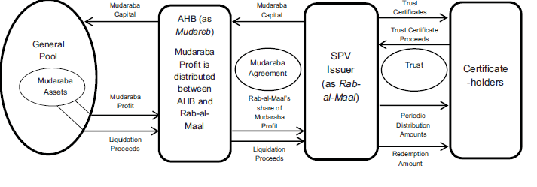
Al Hilal Bank Perpetual Tier 1 Sukuk Structure Diagram
The Issuer will issue Certificates (which shall be perpetual and accordingly shall not have a fixed redemption) to the Certificateholders and collect the trust certificate Proceeds therefrom.
Pursuant to a Mudharabah Agreement between AHB (as Mudareb) and the Issuer (as Raab-al-Maal), aMudharabah will be constituted where under the Trust Certificate Proceeds will be contributed by the Issuer as the initial Mudharabah Capital. TheMudharabah shall commence on the date of the payment of the Mudharabah Capital to AHB by the Issuer and shall terminate on the date that the Trust Certificates are redeemed in full.

Slide 23
Damac Properties Sukuk Transaction Summary
Issuer | Alpha Star Holding Limited
Obligor | Damac Properties
Country of Transaction | United Arab Emirates
Structure | Sukuk Al Ijarah
Issue Size | USD 650 million
Issue Rating | ‘‘BB’’ by Standard and Poor’s Credit Market Services Europe Limited.
Issue Date | 18 June 2014
Tenor | 5-year
Maturity | April 2019
Profit Rate | 4.970% per annum.
Listing | London Exchange /Nasdaq Dubai
Governing Law | English Law and Dubai Law
Joint Lead Managers | ADIB, Barclays Bank PLC, Citigroup, Global Markets Limited, Deutsche Bank AG, London Branch, Dubai Islamic Bank, Emirates NBD Capital and National Bank of Abu Dhabi
Damac in dual listing should encourage more UAE-based companies listed abroad to do the same. With 41 companies from the Middle East and North Africa currently listed on the LSE, analysts and business executives cited London’s lack of constraints as one of the main reasons for listing there.

Slide 24
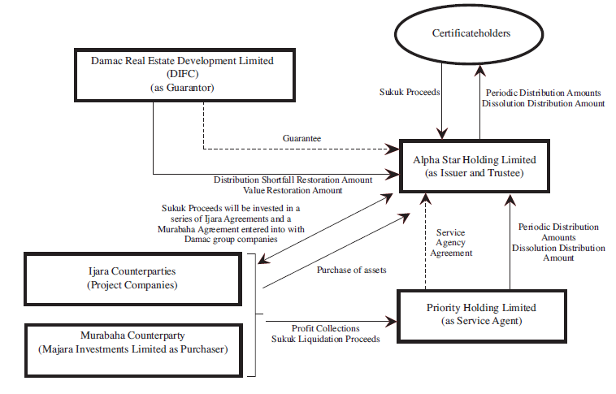
Damac Properties Sukuk Structure Diagram

Slide 25
Recent Developments in Sukuk Market
CIMB plans first Collateralised Sukuk in RM1Bio fund-raising bid
CIMB Group Holdings Bhd plans to sell a sukuk backed by a pool of loans, becoming the world’s first Islamic bank to sell the type of collateralised debt that contributed to the global financial crisis.
Emirates Airline UK guaranteed Sukuk of US$ 913 Bio
Emirates , the Dubai-based airline, issued an Islamic bond that will be guaranteed by Britain's export credit agency,
The deal assumes significance as this is the first time the export credit agency has guaranteed a Sukuk, as Islamic bonds are known.
Malaysia’s Danajamin guarantees aim to diversify Sukuk market
Malaysia's $40 billion sovereign wealth fund Khazanah Nasional plans to issue a sukuk worth up to one billion ringgit ($279.17 million) to help fund schools.
Malaysia Sovereign Sukuk dual-tranche $1.5 Bio
The government of Malaysia priced a dual-tranche $1.5 billion Sukuk after attracting orders of $9.0 billion from Asia, Europe, the Middle East and the United States.
The dual tranche 10 and 30-year Sukuks were priced at 115 basis points (bp) and 170bp over US Treasuries respectively, representing a tightening of 20bp and 15bp from the price guidance given.

Slide 26
Recent Developments in Sukuk Market
Indonesia plans alternative Sukuk structures to boost volumes
Indonesia is aiming to boost volumes of Sukuk by introducing new assets to support the transactions.
The government is considering the use of state goods and services as underlying assets on its Sukuk, which have previously relied on projects and infrastructure assets under the ijara or wakala strutacure
Malaysia's KLK to multi-currency Sukuk
Malaysian plantation company Kuala Lumpur Kepong (KLK) Bhd will raise up to 1.6 billion ringgit ($431.9 million) from Sukuk Issuance
Kazakhstan’s Sovereign Sukuk
Kazakhstan’s parliament has approved a new Islamic finance law, moving the nation a step closer to launching its first sovereign Sukuk
Sukuk Express
National Bonds Corporation, the leading sharia-compliant savings and investments company in the UAE, has launched 'Sukuk Express', a new service that allows customers to deposit up to AED20,000 daily in their National Bonds accounts via 1,000 quick payment machines

Slide 27
Conclusion
It is no surprise that the domestic market is very much Sovereign led, as the domestic market needs local currency instruments to manage their liquidity while the domestic investors prefer to invest in their home currency so as not to be exposed to currency risk. It is likely that most of the Sovereign will keep a bigger share of the local market as Islamic finance activities grow around the globe, more countries will issue Sukuk in their home currency as part of the Government's own funding needs and to develop benchmark curve to facilitate growth of their domestic market. Investors in the local market need to maintain “Risk Free” assets in their portfolio and the Sovereign provides, just that.
In the international cross border market, Corporates were the earlier dominant issuers but only after Sovereign or Quasi Sovereign laid the foundation that provided confidence in the Sukuk as an acceptable and viable instrument (eg. Bahrain, UAE, Malaysia, Qatar, and Islamic Development Bank).

Slide 28
Conclusion
In addition many new Sovereign / Quasi Sovereign issuers lent support to the Sukuk market, (eg. Government of Malaysia, Government of Turkey, Saudi Electricity Company, Islamic Development Bank, Emirates Airlines, Ras Al Khaimah etc.). Not only these chunk size Sukuk issuance from high credit quality issuer helped absorb some of the liquidity but in doing so, liquidity remains high and is paving the way for more Sovereign Debutant Sukuk.
The Sukuk Mutual Funds space is taking shape with number of banks having set up their own Sukuk Fund to offer to their private clients, this is a positive sign, that the Sukuk market is coming of age. Development of the Sukuk Fund is timely, as the current split between Sovereign and Corporate risk is very much desirable, since it offers investors and fund managers with a good mix of Sovereign and Corporate risk to consider. The choice offers the fund manager to not only diversify credit risk but also take into account their risk return profile in allocating to their portfolio.

Slide 29
About International Islamic Financial Market (IIFM)
IIFM is the international Islamic financial market’s organization focused on the Islamic Capital & Money Market (ICMM) segment of the Islamic Financial Services Industry (IFSI).
It was founded in 2002 by the collective efforts of the Islamic Development Bank, Autoriti Monetari Brunei Darussalam, Bank Indonesia, Central Bank of Bahrain, Central Bank of Sudan and the Bank Negara Malaysia (delegated to Labuan Financial Services Authority) as a neutral and non-profit organization. Besides the founding members, IIFM is also supported as member by certain regulatory and government bodies such as, The National Bank of Kazakhstan, Indonesian Financial Services Authority, as well as by a number of international and regional financial institutions and other market participants as its members.
Given IIFM growing presence as a key standard setting organization; IIFM Board of Directors in its 31st board meeting held during 2014 made a strategic decision to expand IIFM scope of work as it is the only standard setting organization which develop standardized Islamic financial contracts and product templates. The BOD approved the inclusion of Corporate Finance & Trade Finance segment in addition to existing focus of Capital & Money Market standard agreements and products templates. This to further enhance the development of Islamic financial industry globally through its documentation and Islamic products unification efforts which are much needed for a robust, transparent and vibrant industry.
To date IIFM has published number of key Standard Master Agreements, including:
IIFM Master Collateralized Murabahah Agreement & its Operational Guidance Memorandum
Interbank Unrestricted Master Investment Wakalah Agreement & its Operational Guidance Memorandum
ISDA/IIFM Tahawwut (Hedging) Master Agreement & Explanatory Memorandum
Mubadalatul Arbaah (Profit Rate Swap) Standard Documentation (Single Sale Structure)
Mubadalatul Arbaah (Profit Rate Swap) Standard Documentation (Two Sale Structure)
Master Agreements for Treasury Placement & Structure Memorandum
IIFM is also in the process of developing several important documentation and product standards related to the Islamic financial market. It has also published global Sukuk reports (first, second and third editions) and organized a number of seminar and workshops.

Slide 30
IIFM Mandate
In the Islamic Financial Services Industry there are three main standard setting bodies with clear mandate for each.
No overlapping in their mandates
They complement one another through a constructive cooperation and collective action as the basis of the relationship between them. The Institutions are as follows:
 | Name of institution | Headquarter/Office | Date of establishment | Mandate
1 | AAIOFI: Accounting and Auditing Organization for Islamic Financial Institutions | Manama Kingdom of Bahrain | 26 February, 1990 in Algiers. Then registered on 27 March, 1991 in the Kingdom of Bahrain | General Shari ‘ah rulings & Accounting Standards.
2 | IFSB: Islamic Financial Services Board | Kuala Lumpur Malaysia | Inaugurated officially on 3rd November 2002 and started operations on 10th March 2003 | Regulatory and Supervisory aspect of the Islamic Financial Industry.
3 | IIFM: International Islamic Financial Market | Manama, Kingdom of Bahrain | Became officially operational on April 1, 2002 but revised strategic Plan implemented in 2007 | Product and documentation standardization of all financial contracts & product templates globally
4 | CIBAFI: General Council for Islamic Banks And Financial Institution | Manama, Kingdom of Bahrain | Established in 2001. | Representing the Islamic financial services industry globally, defending and protecting its role

Slide 31

Shukaran Wassalamu ‘Alaikum
International Islamic Financial Market (IIFM)
Office No. 72, 7th Floor, Zamil Tower (Main Tower), P.O. Box: 11454, Manama, Kingdom of Bahrain
Tel: +973 17500161 , Fax: +973 17500171, Email: info@iifm.net, Website: www.iifm.net
Disclaimer: The information herein has been obtained from sources believed to be reliable but cannot be guaranteed. The views or opinions expressed are subjected to change at any time. Neither the information nor any opinion expressed can be construed as a solicitation for the purchase or sale of any securities. International Islamic Financial Market disclaims liability in this respect.

