Slide 1
Case studies:
Sukuk for infrastructure
Salman Khan

Slide 2
Case studies: Sukuk for infrastructure
Investments in infrastructure by 2030 require an estimated USD 71 tr (OECD)
  Road, rail, telecommunication, electricity and water
(without including seaports, airports and social infrastructure)
==> around 2.5% of global GDP to 2030
Expected required infrastructural investment in the GCC between 2010-20: USD 535 bn to 2 tr
GCC also key market for sukuk issuances
Africa: annual infrastructure financing gap of USD35 bn per year (WB)
** Statistics courtesy of MIFC

Slide 3
Case studies: Sukuk for infrastructure
Emerging markets: USD 21 tr during 2008-18 (International Finance Corporation)
Implication:
  huge need for infrastructural development <= => sukuk
Recent years: sharp increase in sukuk for infrastructure and development
Example: 2012
  Unprecedented new sukuk = USD 27.8 bn (^ 140%)
Infrastructure sukuk = 21.2% of total global sukuk
** Statistics courtesy of MIFC

Slide 4
Case studies: Sukuk for infrastructure
Malaysia at the top (US 20.37 bn)
Others:
  Saudi, Indonesia, Pakistan, Kuwait, Brunei
Different sukuk structures used
Ijara, murabaha, musharaka (most common: 79% in recent years)
Again: much potential for sukuk
However: also various issues
Look at some prominent case studies, and associated issues
** Statistics courtesy of MIFC

Slide 5
Case studies & discussion
Dubai Civil Aviation (DCA) Sukuk
11/2004 for $1 bn
Basic SLB (Ijara) template
Sale of DCA assets to sukukholders
=> leased back to obligor
Fixed lease term
Lease payments: income generated by airport operation
Repurchase of assets

Slide 6
Case studies & discussion
DCA Sukuk
Purpose: to fund second phase of expansion of Dubai International Airport
Infrastructure expansion due to rising passenger traffic (1998: 4.3m; 2003: 18m, 2010: 60m; 2015 end: 90m)
World's biggest Sukuk (then)
Five-year maturity
Listed and traded at DFM

Slide 7
Case studies & discussion
DCA Sukuk
Seller
Dubai Government, DCA
Purchase Agreement
Sale of Sukuk Assets
Purchase
price
Master Lease Agreement of Sukuk Assets
Exercise Price
Lessee/Servicing Agent
Dubai Government, DCA
Issuer/Trustee
Dubai Global Sukuk FZCO
Sale of Sukuk Assets
Obligor
Government of Dubai, DCA
Lease rentals
Service Agency Agreement
PU
Issue Proceeds
Periodic Distribution amounts and Redemption Amounts
Certificates
Investors

Slide 8
Case studies & discussion
DCA Sukuk
Some issues
Look at them shortly (following next case study)

Slide 9
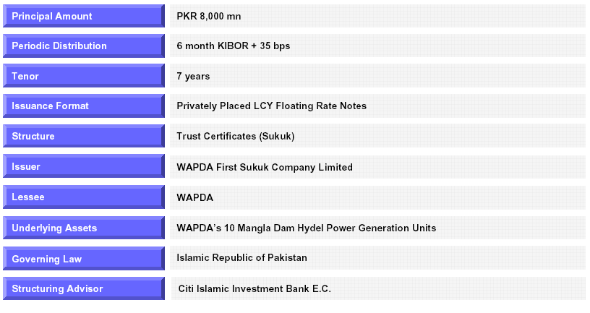
Case studies & discussion
WAPDA Sukuk
(snapshot)

Slide 10
Case studies & discussion
WAPDA Sukuk
02/2006
Rs 8 billion (= AED 0.5 billion)
7 years
Sovereign sukuk
Ijara structure

Slide 11
Case studies & discussion
Purposes:
  Infrastructure sukuk: to fund Mangla Dam raising project
  Obtain finance cost efficiently
  Strengthen presence in local financial markets
  Diversify and expand investor base
  Promote Islamic Finance with a view to encouraging other public entities

Slide 12
Case studies & discussion
WAPDA Sukuk
Structure:
  Purchase of WAPDA’s turbines
  Lease back to WAPDA
  “First Demand” guarantee GoP
  PU from WAPDA

Slide 13
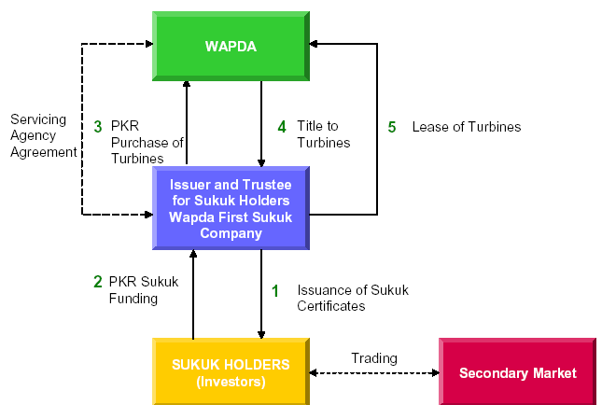
Case studies & discussion
WAPDA Sukuk

Slide 14
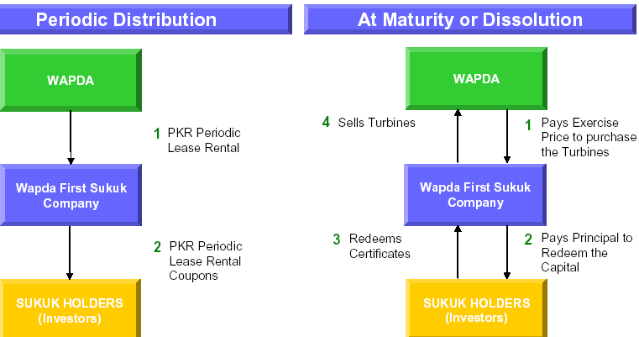
Case studies & discussion
WAPDA Sukuk

Slide 15
Case studies & discussion
WAPDA Sukuk
Issues:
  “Lessee”?
  Ownership?
    PU
    Only → Obligor
  “Commanding heights” (?)
  Possible?
  3P X: implication?
Price of sale?
  Fv
  Ok?
Due diligence/feasibility
  Project/activity
  Obligor?
Shortly: ijara v mudaraba
comparison

Slide 16
Case studies & discussion
DP World Mudaraba Sukuk:
07/2007
Sovereign Sukuk
10 year tenor
DPW: international operator of container terminals
Requirement of finance for infrastructure and expansion

Slide 17
Case studies & discussion
DP World Sukuk
DPW: international operator of container terminals
  Operation in 22 countries
42 terminals
  UAE, ME, Europe, Africa
  Asia-Pac, Indian Sub-continent
  Australasia, Americas
Purpose:
  Develop infrastructure
  Expand operations
  Terminal 2 (additional terminal adjacent to Jebel Ali Terminal within JAFZ)

Slide 18
Case studies & discussion
DP World
DP World Ltd
(Mudarib)
Periodic Distribution of Amounts
Proceeds
of Certificates
Mudaraba Agreement
Purchase and Sale Undertakings
DP World Ltd
(Obligor)
DP World Sukuk Ltd
(Issuer and Trustee pursuant to Declaration of Trust)
Exercise Price *
Interest under Sharia in Mudaraba Assets
Periodic Distribution Amounts and Dissolution Distribution Amount
Proceeds of Certificates
Declaration of Trust
Investors

Slide 19
Case studies & discussion
DP World Sukuk
Lead Arrangers:
  Barclays
  DB
Trust over Mudaraba assets
Mudaraba assets:
  Share of DPW assets (mudaraba capital)
  Mudarib: DPW
Profit:
  Biannual profit distribution (99:1)
  DIB
  Citigroup

Slide 20
Case studies & discussion
DP World Sukuk
Perfomance incentive (bonus):
  Periodic profit payments
  If > : all excess to DPW (as Mudarib)
  If < : “SC liquidity facility”
Liquidity facility:
  Operation?
  Loan: return?
Construction liquidation price:
  Capital + + SCLF
∏
∏
∏

Slide 21
Case studies & discussion
DP World Sukuk
∏
Mudaraba: expected
If < ?
Concepts:
  “Feasibility study”
  “Responsibility”
PU by DPW (closing date)
Formula-based EP
Purpose: guarantee
AAOIFI?

Slide 22
Case studies & discussion
AAOIFI’s position on Sukuk
Tradeability:
Investment sukuk
  Includes: mudaraba, musharaka, wakalatul istithmar (ownership of assets)
  Prior to activity commencement: Sarf, debt
  Nominal (fv) X
Implication?
  PU?
One further angle:
  Business versus lease

Slide 23
Case studies & discussion
AAOIFI’s position on Sukuk
Investment sukuk
  Mudaraba, musharaka, wakalatul istithmar
  Nominal (fv) X
Ijara sukuk:
  May redeem at market price “or at a rate agreed upon” (i.e. fv)
  Does not apply to partnership/agency
Comment (’08)
Big debate
  Focus: partnership sukuk
  “85% non-SC”

Slide 24
Case studies & discussion
Opinion?
Key issue here?
  PLR
  Guarantee
  Other’s expense
  Risk →
  Credit versus project activity (risk)
What about Ijara sukuk?

Slide 25
Case studies & discussion
AAOIFI’s position on Sukuk
Ijara sukuk
  Lessee
  Agent
  Agent guarantee X
  Rewind: guarantee (fundamental)
  Lessee : Agent X
  Why (basic principle) ?
  Equal playing turf?
  Consequence: ijara sukuk ‘blue-eyed boy’
  Opinion?

Slide 26
Snapshot
The Express Tribune (March 10, 2013)
Use of Sukuk to meet govt’s borrowing requirements (excerpt)
By Humayon Dar
“In the medium to long run, Sukuk can be used as an instrument to discipline public sector borrowing, as Sukuk requires an asset to be used to raise financing. This requirement is an inbuilt mechanism to restrict an issuer’s (including the government’s) ability to borrow money freely.
In the past, the government used the M2 motorway to raise $600 million through an Ijara Sukuk (based on leasing) for a period of five years (2005-11). Those who are against the use of Quaid-e-Azam International Airport Karachi for the issuance of Sukuk last year must keep in mind that this structure is far safer than the previous M2 Sukuk, which was offered to international investors.
The government remained adamant that it would not allow the investors (Sukuk holders) any recourse to the underlying asset (M2 motorway). The Karachi airport Sukuk also does not provide recourse to the Sukuk holders in case of sovereign default (although from Shariah viewpoint it is better to give the investors recourse to the underlying asset). So, any fears that the government is endangering assets of national security by channelling it to the private sector are ill informed.”

